Slide 1

Ecommerce
The benefits of ecommerce and drawbacks for young people

Slide 2







Major ecommerce sites

Slide 3
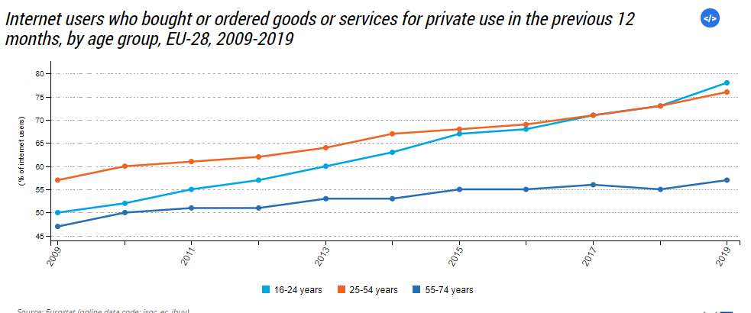
Ecommerce – ages that use it

Slide 4
Benefits of ecommerce
Can get any Item from anywhere in the world
Cheaper than traditional retail
Provides comparison shopping
Provides reviews of an item allowing a consumer to make a more informed decision
Creates markets for niche products

Slide 5
Drawbacks of ecommerce
Create a consumer mind frame
Put small offline businesses out of business
Have to be in for delivery’s
Doesn’t let you see the product before it’s arrived
Returns can be difficult

Slide 6
Young People Elderly People
Benefits
Access to a wider variety of products
Helps get items with a “Stigma” around them
Drawbacks
Removes from social interaction
Gives another reason to not leave the house
Benefits
- Helps them get grocer

Slide 7

Thank You!
someone@example.com

